Slide 1
COSMOS: Cluster #11 Intro to Autonomous Vehicles
Introduction to Open CV Python - 2
Kishore Nukala
ECE Grad Student

Slide 2
Outline:
Introduction to various functions in Open CV
Implementation of OpenCV on test images for successful lane detection
Discussing different approaches for lane detection and Navigation ( HoughLines, Color Segmentation, Perspective Transform)
Setup Jetson Nano for using Python and Open CV
Integrating with camera on robot to receive feed and process for lane detection
Implement an algorithm for controlling the motors based on the processed images

Slide 3

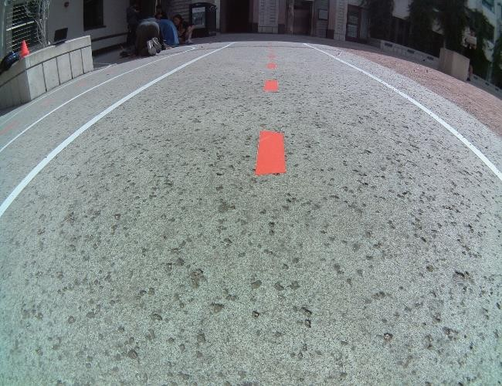
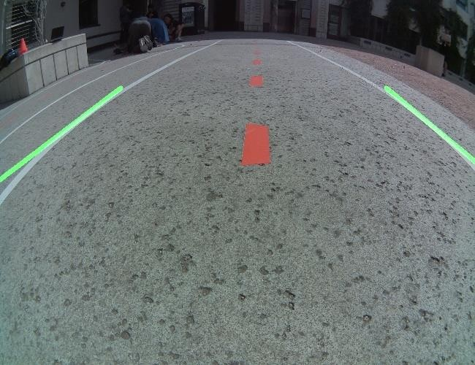
OpenCV Lane Detection

Slide 4
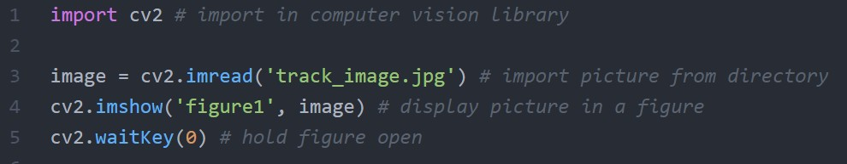
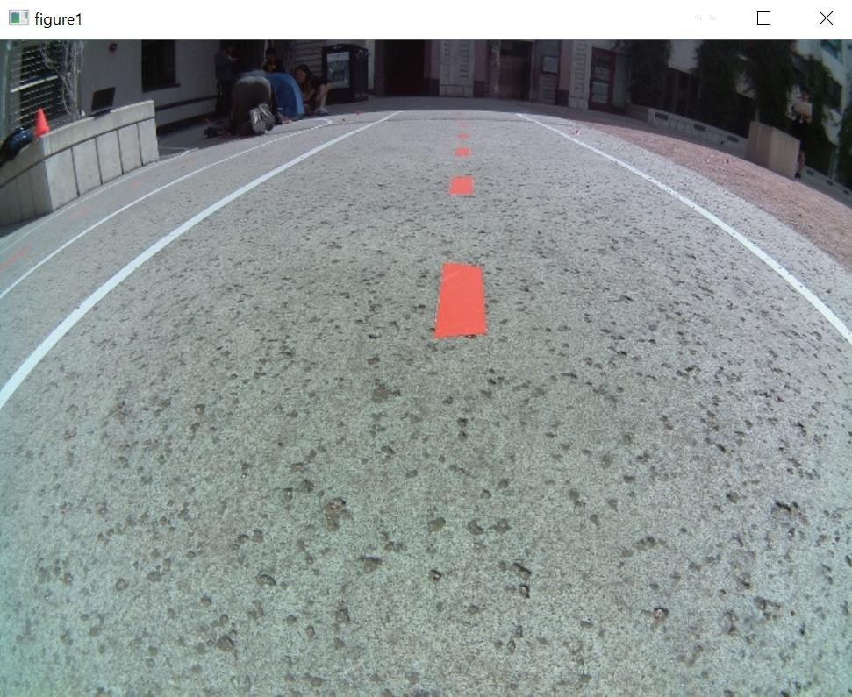
Import and Display Image
New functions:
cv2.imread(‘file_name.ext’)
cv2.imshow(‘plot_name’, image)
Cv2.waitKey(0)

Slide 5
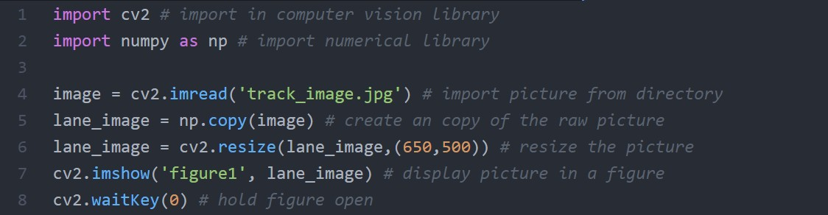
Copy and Resize Image
New functions: np.copy(image)
cv2.resize(image,(width,height))

Slide 6
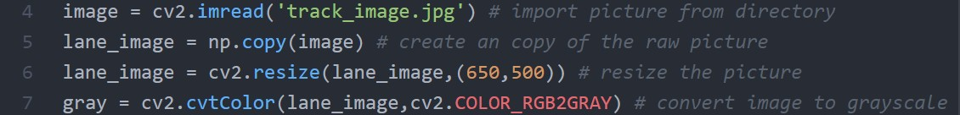
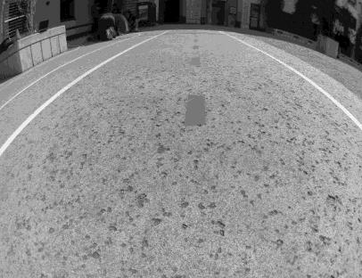
Convert to Gray
New functions: cv2.cvtColor(image,cv2.COLOR_RGB2GRAY)
Original
Gray

Slide 7
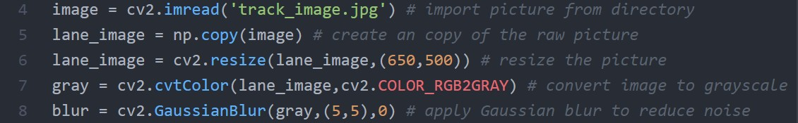
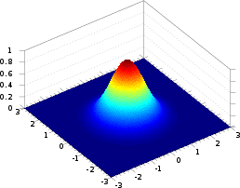

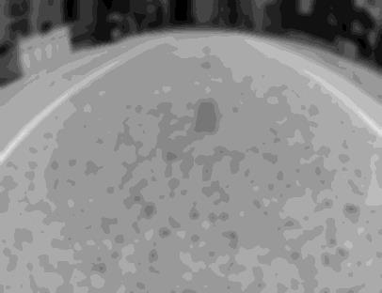

Smoothen Image
New functions: cv2.GaussianBlur(image,(kernel_size),sigma)
Gray
Blur (5x5)
Blur (25x25)

Slide 8
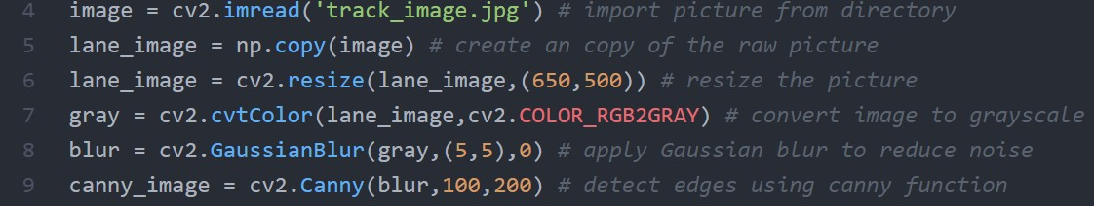
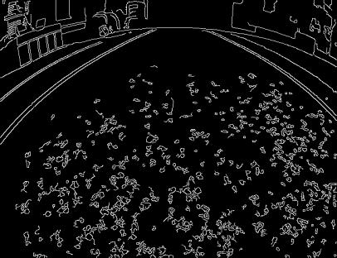
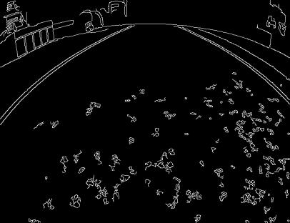
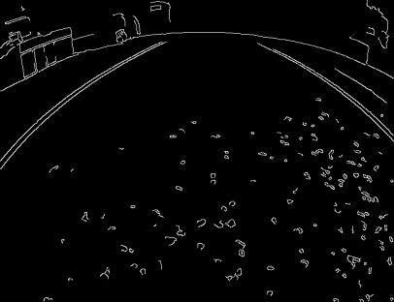
Edge Detection using Canny
New functions:
cv2.Canny(image, lower_threshold, upper_threshold)
Original
Threshold: 50-150
Threshold: 50-200
Threshold: 100-200

Slide 9
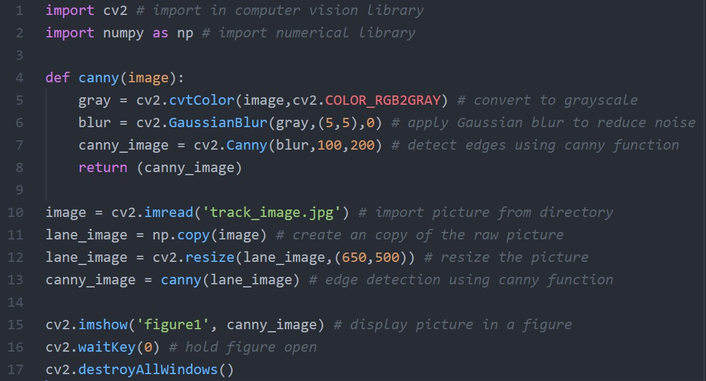
Define New Function
Define function
Call on function

Slide 10
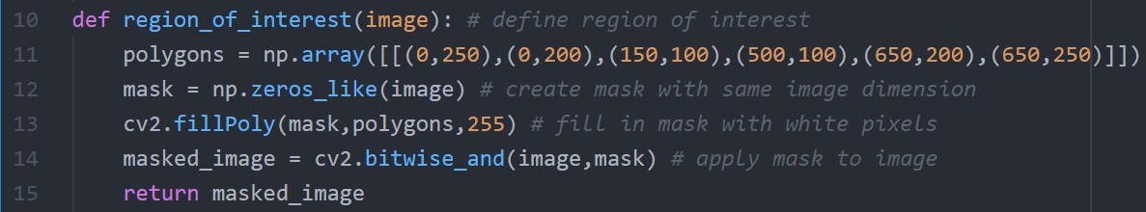

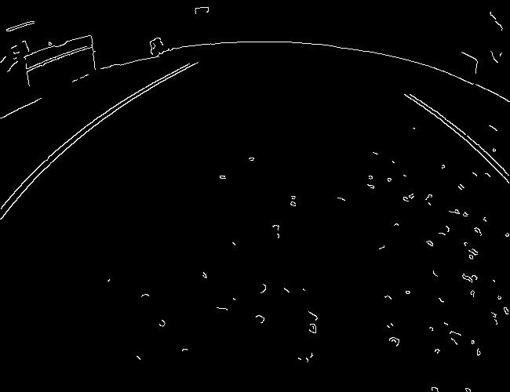
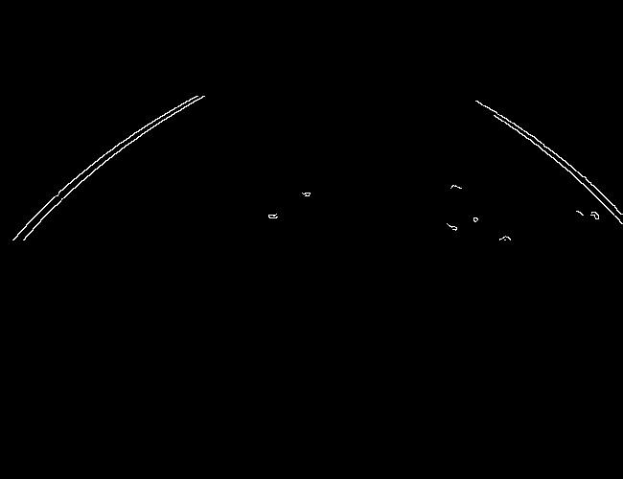

Region of Interest and Mask
ROI
Canny Image
Cropped Image

Slide 11
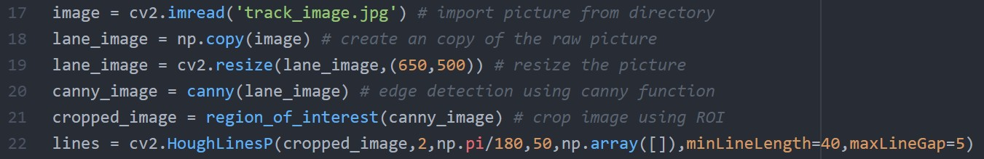
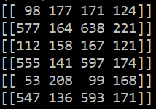
Find Lines using Hough Transformation
New functions:
cv2.HoughLinesP(image, ρ, θ, threshold, output, min_length, max_gap)
Minimum # of points in the [ρ, θ] bin
Each row is a 2D array containing all line coordinates in the form of [[x1 y1 x2 y2]]
Cropped Image

Slide 12
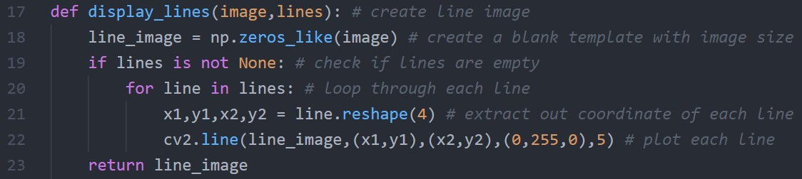
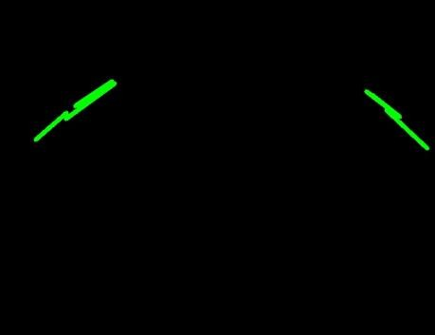
Plotting Detected Lines
New functions:
line.reshape
cv2.line(image, (x1,y1), (x2,y2), color, line_width)
Line Image

Slide 13
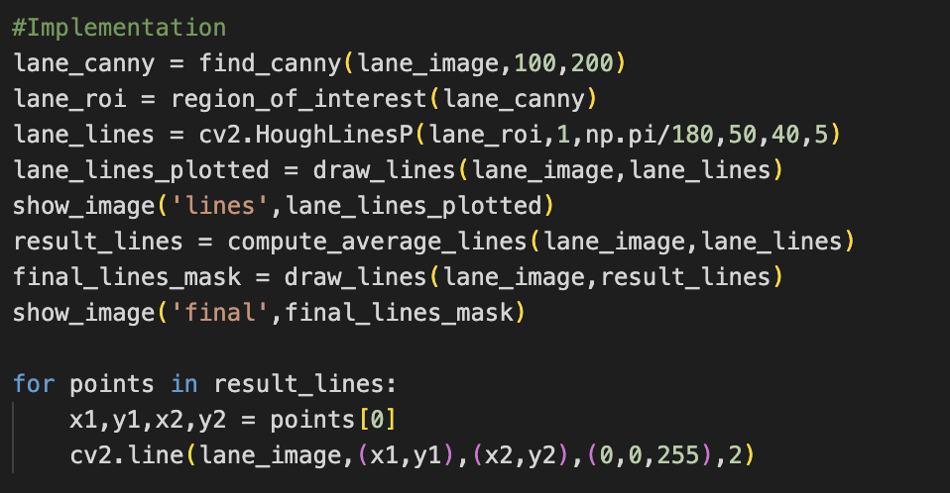
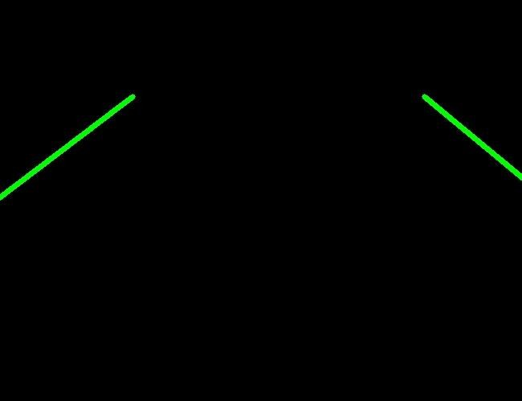
Average Detected Lines
Lane Image
Average Lane Image

Slide 14
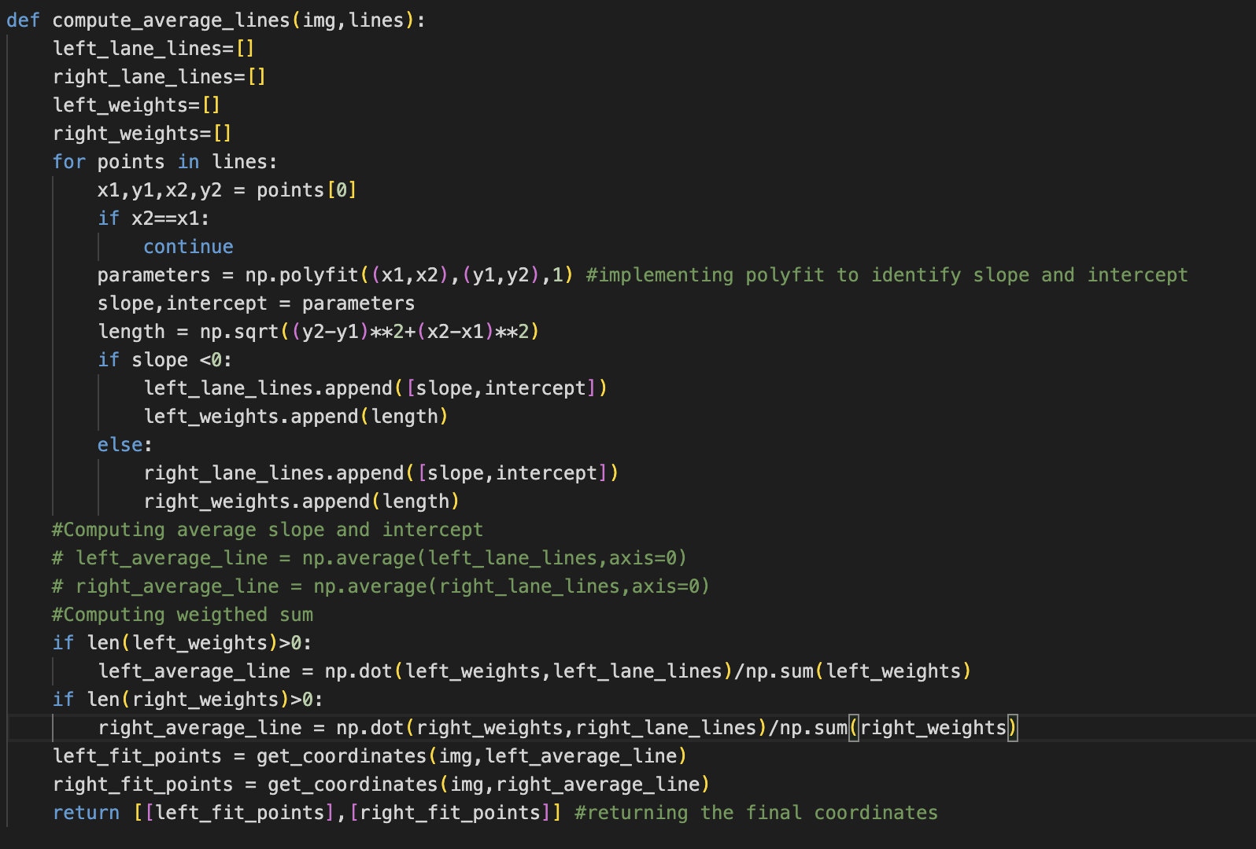
Average Detected Lines

Slide 15
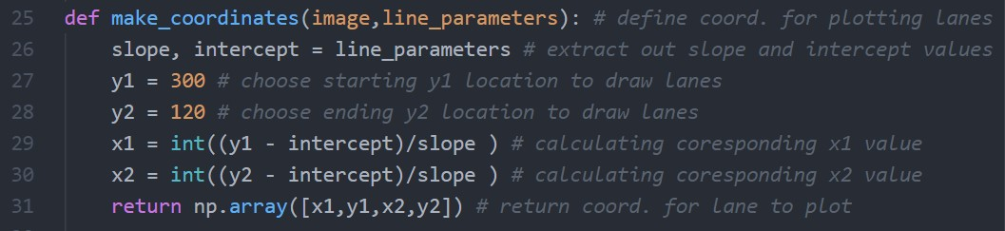
Average Detected Lines
x
120
300
y
Average Lane Image

Slide 16
Combine Lane Image
Raw Image
Detected Lanes
Combine Lane Image

Slide 17
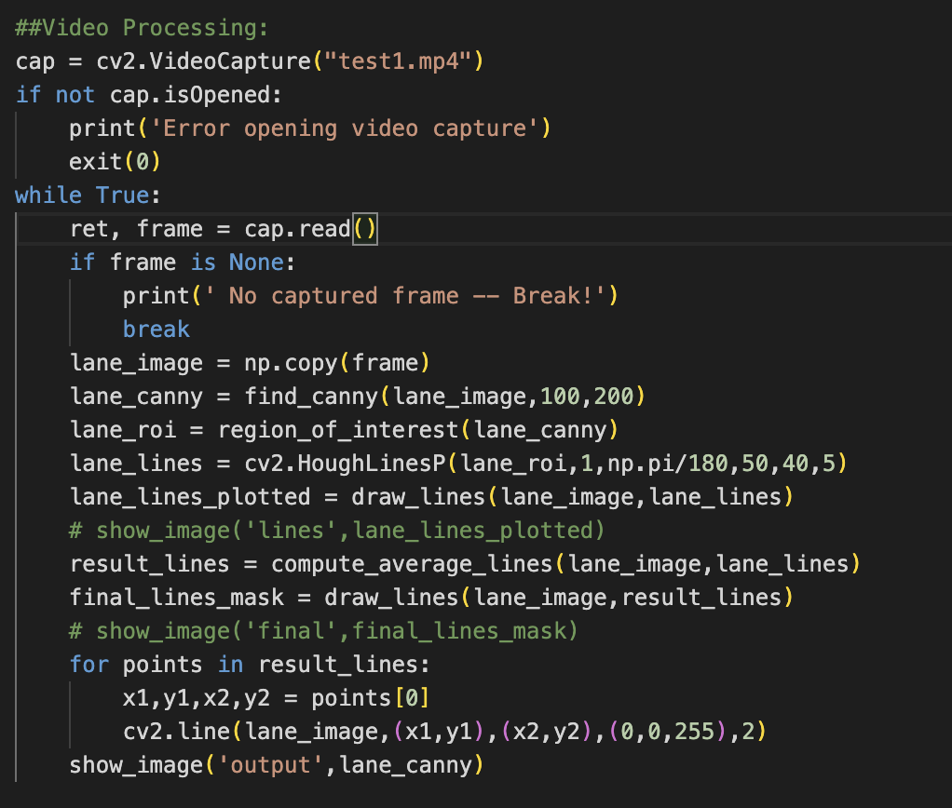
Apply to Video

Slide 18

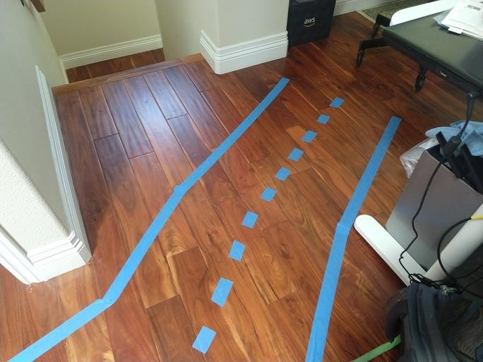
OpenCV Color Segmentation

Slide 19
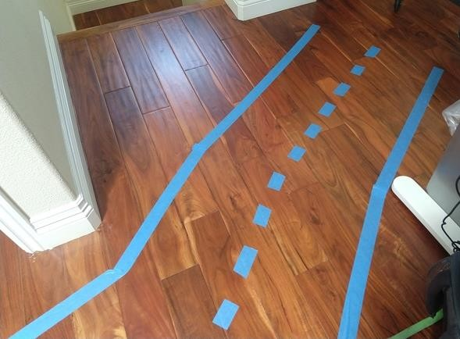
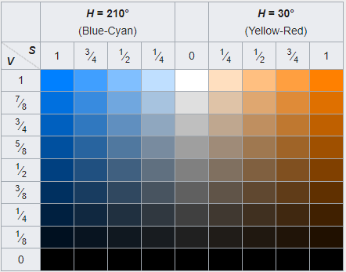
HSV Color Space

Slide 20
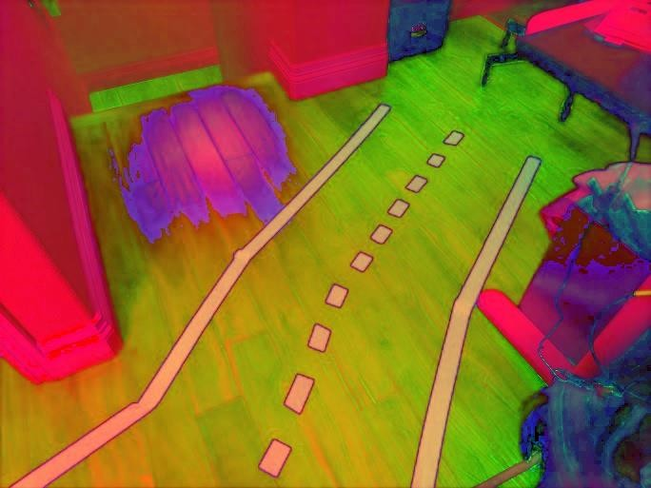
Changing Color Space
New function:
cv2.cvtColor(image, cv2.COLOR_BGR2HSV)
RGB
HSV

Slide 21

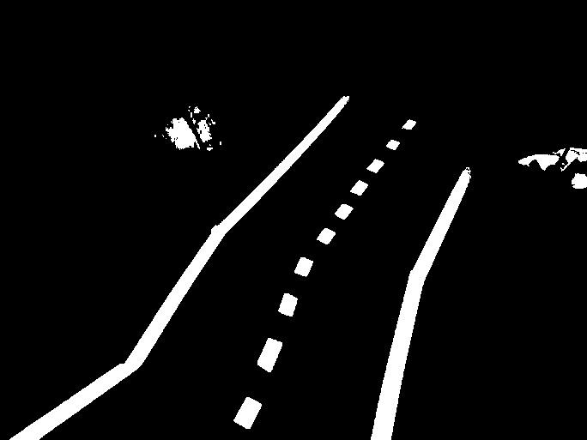
Filtered with Color
New function:
cv2.inRange(image, lower_threshold, upper_threshold)

Slide 22

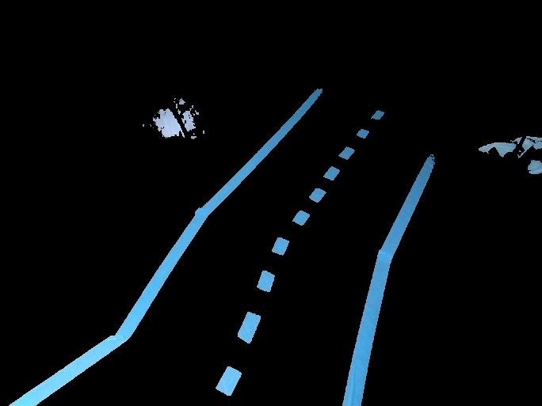
Filtered with Color

Slide 23

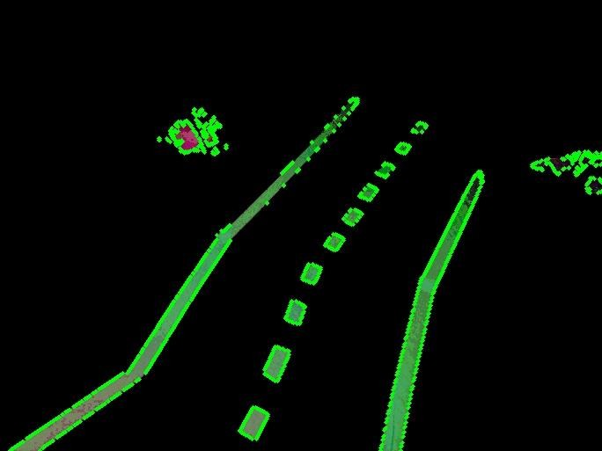
Finding Contours
What to do with these centroids? cv2.moments # find centroids of contours
https://learnopencv.com/contour-detection-using-opencv-python-c/

